Slide 1
Convolutional Neural Network
Chul Min Yeum
Assistant Professor
Civil and Environmental Engineering
University of Waterloo, Canada
CIVE 497 – CIVE 700: Smart Structure Technology
Last updated: 2019-03-28

Slide 2
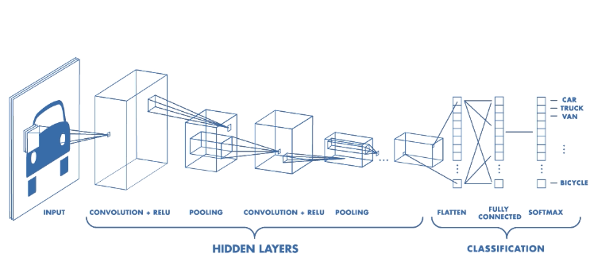
Convolutional Neural Network

Slide 3
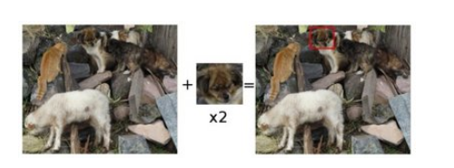
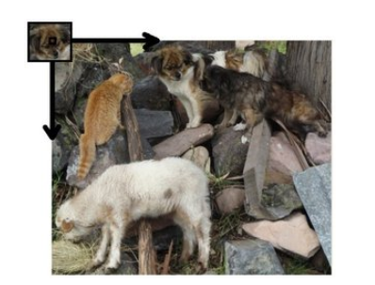
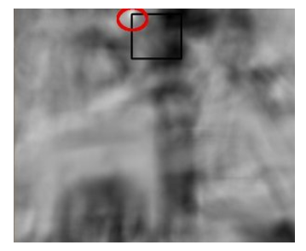
Revisit: Example: Finding Same Objects on Images
https://docs.opencv.org/2.4/doc/tutorials/imgproc/histograms/template_matching/template_matching.html

Slide 4
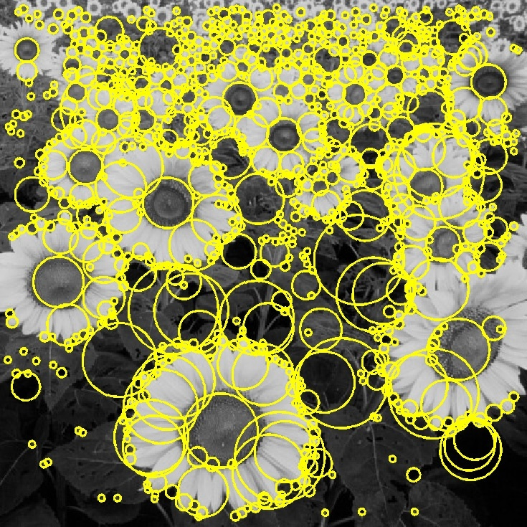

Revisit: Gaussian Filter
Convolve the image with a “blob filter” at multiple scales and look for extrema of filter response in the resulting scale space

Slide 5
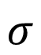
Octave
$$σ$$
increase
f/2
f

Slide 6
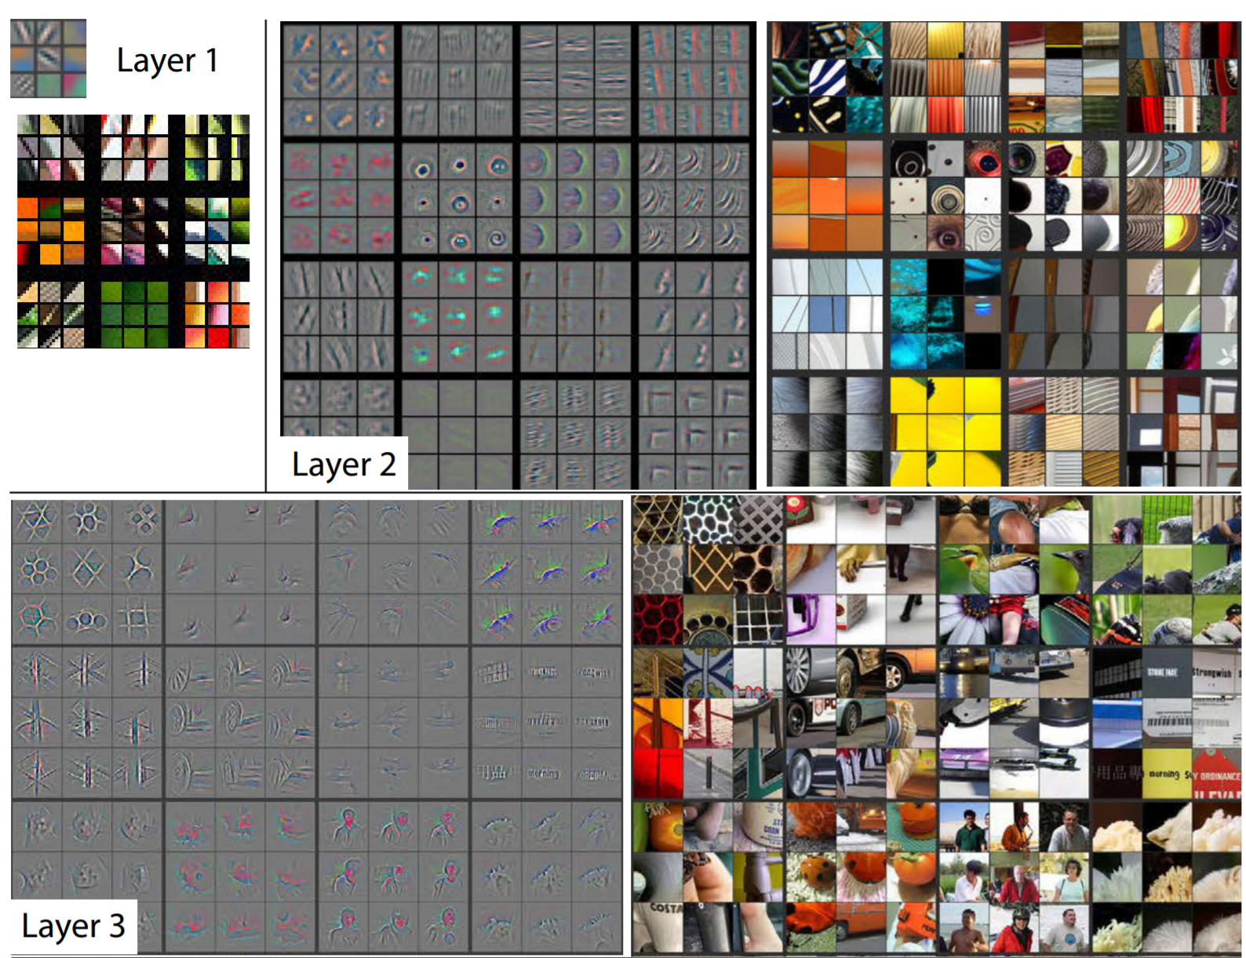
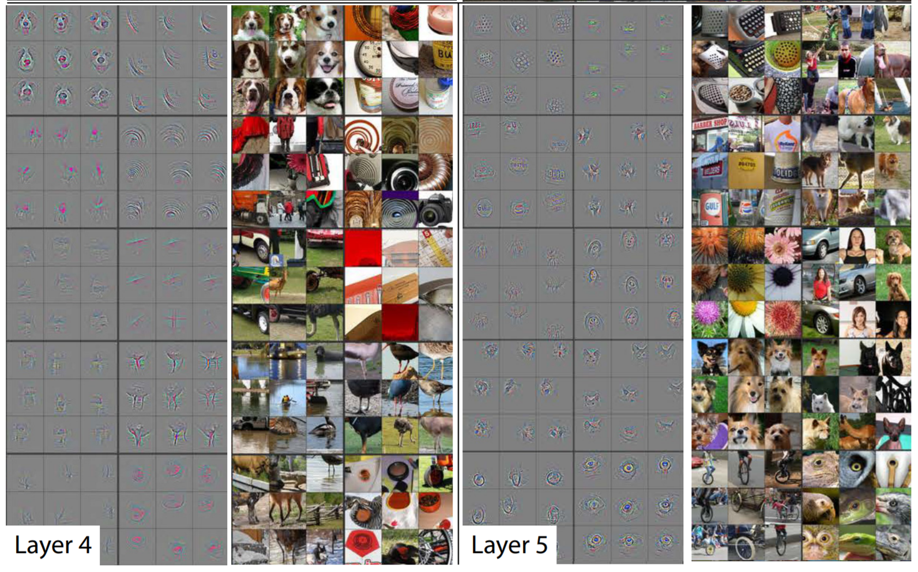
Visualizing and Understanding Convolutional Neural Network
https://cs.nyu.edu/~fergus/papers/zeilerECCV2014.pdf

